Slide 1
Folder Maker And Organizer Tool
This tool is designed with the thought of making your life easier while starting up new projects and keeping them nice and neat with a button press.

Slide 2
Folder Maker And Organizer Tool Features
Makes all dev, art and other(extra needed) folders
Organizes your whole project for just dev, art or other things with one button press or just organize one specific file type with one button press
Saves / Refreshes all your assets
(this will not save your scene view)

Slide 3
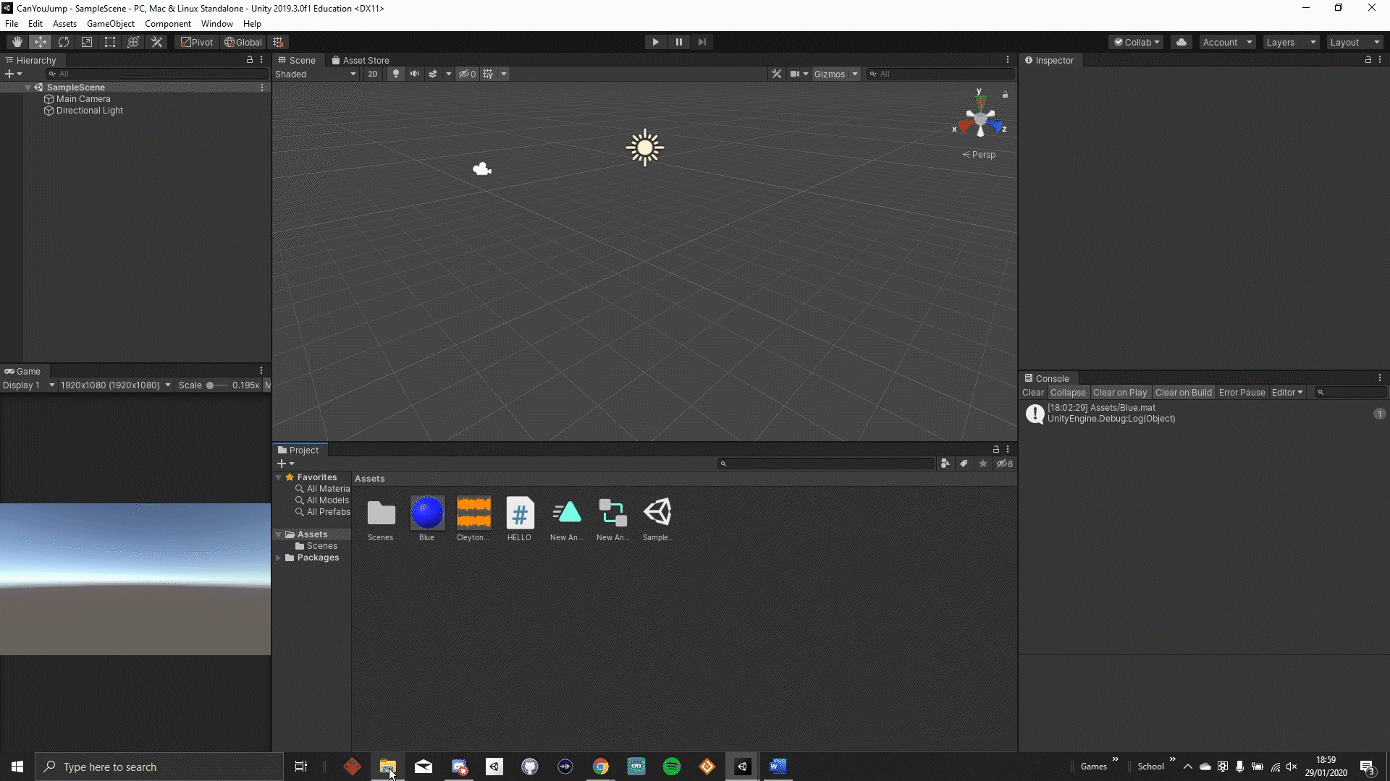
How to start using the Folder Maker And Organizer Tool in unity

Slide 4

How The Folder Maker And Organizer Tool Works
*Video Contains music*

Slide 5
Known Issues
If you make a folder that's already there it will make an extra one.
Every time you click an organize button it will organize all the .insertFileExtentions you are trying to organize ( this costs performance issues ).
- Fix is on its way -

